Slide 1
Stress

Slide 2
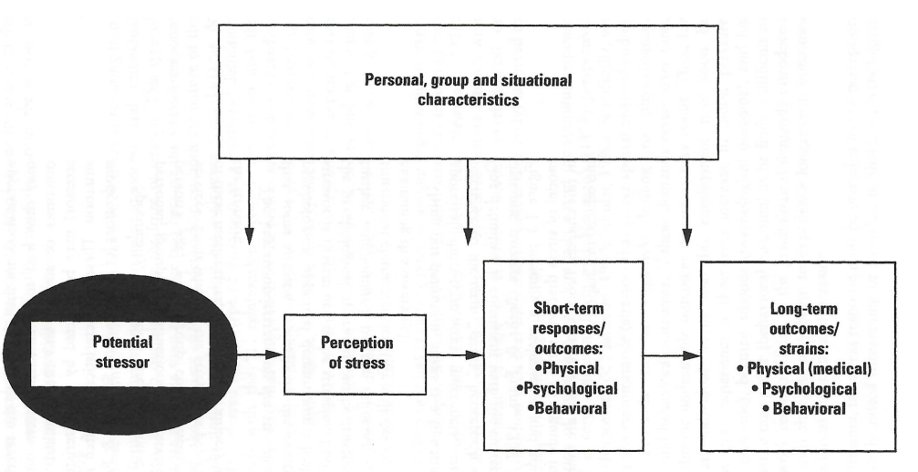
Stress
Stress: the process by which we perceive and respond to certain events, called stressors, that we appraise as threatening or challenging.
Stressor: any event, force, or condition that evokes physical or emotional stress.

Slide 3
Myths about Stress
You should strive to eliminate all stress in your life.
Eustress: stress in moderation, activates motivation to achieve goals.
Gives us opportunity to meet challenges.
Stress is “just in your head.”
Stress linked to mental and physical illness.
Stress implies excess, such as too much work or stimulation.
Being bored or under-stimulated can also be stressful.

Slide 4
Measurement of Stress
Physiological measures
Heart rate, blood pressure, muscle tension, respiration.
Self-report
Surveys, interviews
Limitation: might be under-reported or not reported at all.
Behavioral
Number of errors
Absenteeism

Slide 5
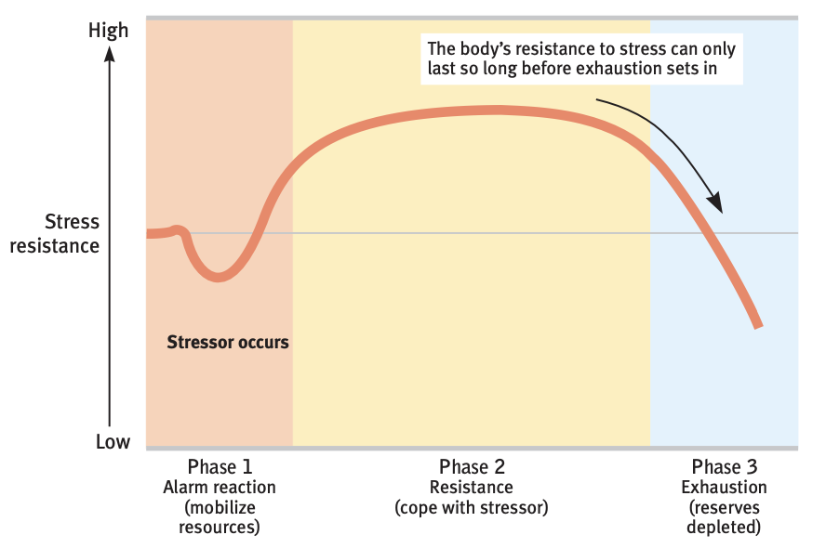
General Adaptation Syndrome
Phase 1
Shock, then fight or flight.
Phase 2
Immune system shuts down.
Phase 3
Burnout

Slide 6
Responses to Stress
General adaptation syndrome
Fight or flight.
Withdrawal
Pulling back, conserving energy.
Organizational withdrawal responses: absenteeism, turnover, procrastination.
Tend and befriend
Banding together and seeking/providing support.

Slide 7
Stressors
Catastrophes
Unpredictable large-scale events.
Physical and psychological toll.
Post-traumatic growth: perception of beneficial change or personal transformation in the struggle to overcome adversity.
Significant life changes
Most keenly felt in early adulthood.
Daily hassles
Potentially most significant sources of stress (chronic stress).

Slide 8
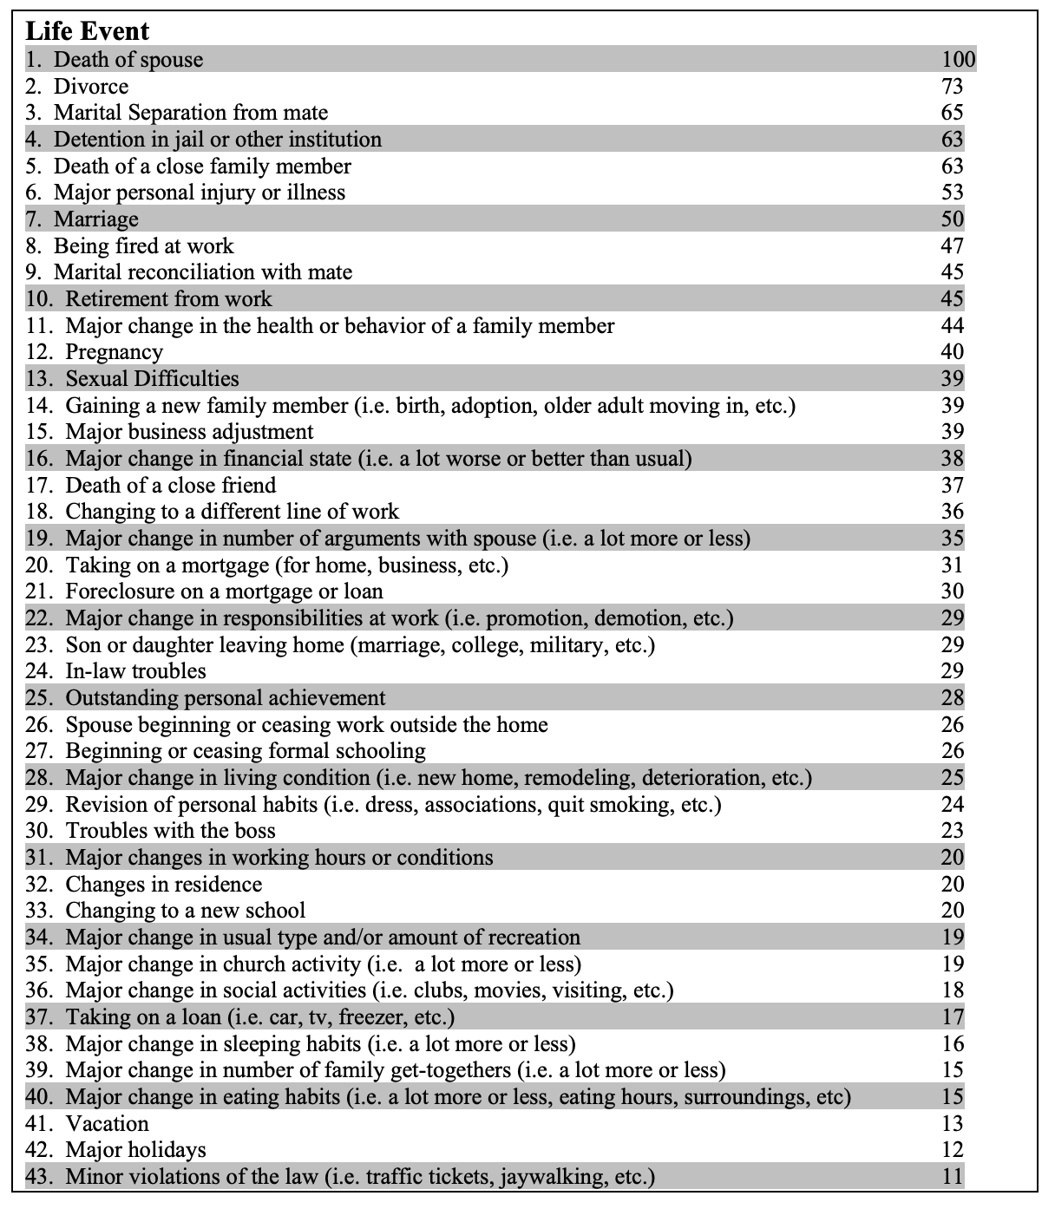

Slide 9
Appraisal of Stressful Situations
Primary appraisal
Initial decision regarding whether an event is harmful and how stressful it is to you.
“Is this situation stressful?”
Secondary appraisal
Perceptions regarding our ability to cope with an event.
“What can I do about the stressful situation?”

Slide 10
Physiological Effects of Prolonged Stress
Impaired ability to focus and commit information to memory.
Cellular level change.
Lifespan differences.
Disrupts the body’s immune system, weakening its natural defenses (immune suppression).
Increased risk of physical and psychological health issues (e.g. coronary heart disease, high blood pressure, depression).

Slide 11
Coping with Stress
Coping: alleviating stress using emotional, cognitive, or behavioral methods.
Problem-focused coping:
Focus on changing the stressor itself.
Useful when sense of control is high.
Emotion-focused coping
Focus on changing your emotional reaction to the stressor.
Useful when sense of control is low.
E.g. post-traumatic growth.

Slide 12
Factors that Influence Stress
Control
Less autonomy → more stress.
Wealth/ status
High wealth or status → less stress.
Wealth/ status often come hand in hand with control.
Wealth/ status allow opportunity to eliminate potential stressors.
Locus of control
Activity: Locus of Control questionnaire.

Slide 13
Locus of Control Scoring
Score 1 point for each of the following:
2a
3b
4b
5b
6a
7a
9a
10b
Highest possible score is 23 points.
High score = External locus of control
Low score = Internal locus of control
11b
12b
13b
15b
16a
17a
18a
20a
21a
22b
23a
25a
26b
28b
29a

Slide 14
Factors that Influence Stress
Internal locus of control
You are in control of events that impact your life.
“What actions can I take to change my situation?”
External locus of control
External factors outside of your control impact your life.
“There’s nothing I can do to change my situation.”
Internal locus of control → less stress.
Domain-specific locus of control.
Cultural differences.

Slide 15
Factors that Influence Stress
Optimism
“Type A”: negative emotions → more prone to stress, burnout, health concerns.
Optimism → more effective coping, lower stress, better health.
Adaptive optimism vs. maladaptive optimism.
Humor
Resilience
The capability of individuals to cope successfully in the face of significant change, adversity, or risk.
Resilience stronger when people have a sense of purpose/ strong personal values.

Slide 16
Factors that Influence Stress
Social support
Strong social ties: family, friends, community, pets
Informational support
Instrumental support
Emotional support
Exercise, relaxation, meditation
Boosts mood, relaxes muscles, produces sleep.

Slide 17
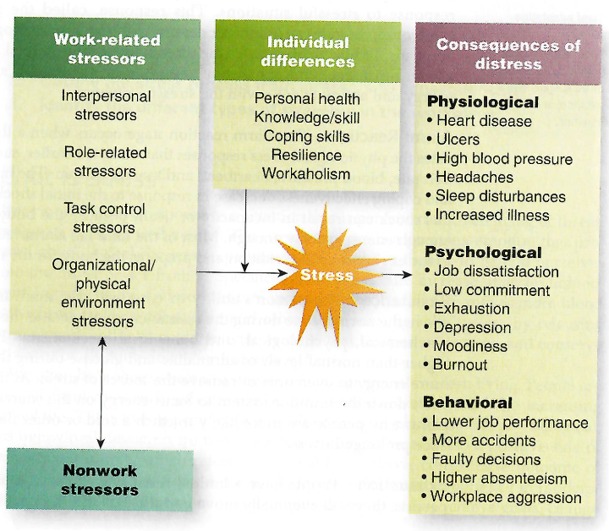
Workplace Stressors

Slide 18
Interpersonal Stressors
Workplace politics.
Conflict with coworkers, manager.
Workplace violence.
Psychological or sexual harassment.

Slide 19
Role-Related Stressors
Role conflict
Incongruity or incompatibility of expectations associated with a person’s role.
Role ambiguity
Lack of clarity and predictability of the outcomes of a person’s behavior.
Work overload
Working more hours and more intensely than can be reasonably handled.
“Ideal worker” norm.
Self-imposed, peer influenced or company/ industry culture.

Slide 20
Task Control & Physical Environment
Task control stressors
Low task control increases stress
Interaction of task control and burden of responsibility.
Organizational and physical environment stressors
Job security
Workplace safety

